Slide 1

Prince’s Trust – Achieve Programme
2022-2024

Slide 2
What is the Prince’s Trust Achieve Programme?
This qualification is a coursework-based subject with no exams.
Students complete the assigned tasks in class which contribute towards their GCSE.
This course is a Level 2 course which is the equivalent of a GCSE.
The focus of the course is learning life-skills that will stand by students when they leave school.

Slide 3
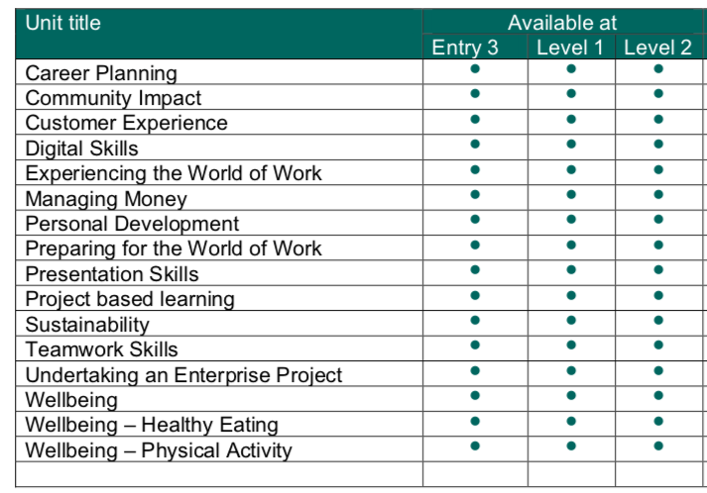
Here are some examples of the units covered in the Achieve programme

Slide 4
Other information
Students will be provided with workbooks for each unit. These will be completed during class time.
The workbooks will be sent for moderation and an appropriate Level will be awarded to the student.
Over 2 years the students will complete several units which focus on life after school, e.g., finance, getting a job, setting up a business.

Slide 5
Any questions?
If you have any questions at all about the Prince’s Trust, you can call up and see me ☺
Visit the Prince’s Trust website if you need some more information https://www.princes-trust.org.uk/help-for-young-people/unlock-your-potential/explore-your-potential
You can send me an email on amurphy873@c2kni.net

